Slide 1
Concepts of RCC/PCC
For Integrated group

Slide 2
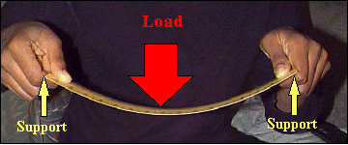
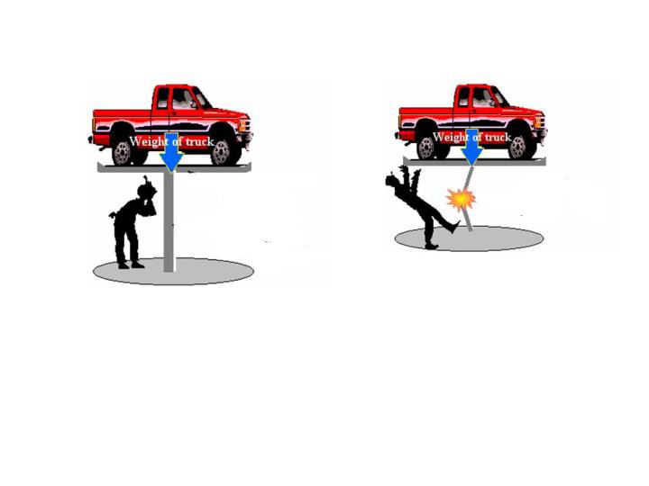
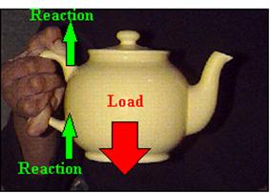
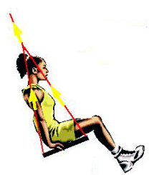
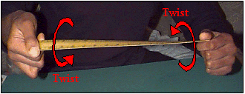
Basics - Loads
Bending
T
Compression
Shear
Tension
Buckling
Torsion

Slide 3
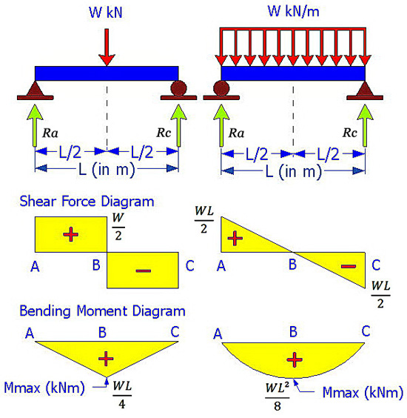
Basics – Forces on Beams
Vertical Loads
Shear Force
Bending Moment

Slide 4

TYPES OF SUPPORTS
Simple
V
H
H
Hinged
V
V
H
M
Fixed
V

Slide 5
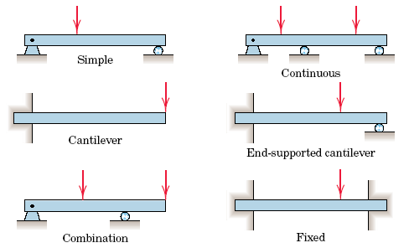
Introduction to Beams
Beams are supported in structures via different configurations

Slide 6
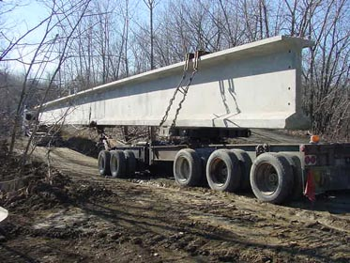

Slide 7
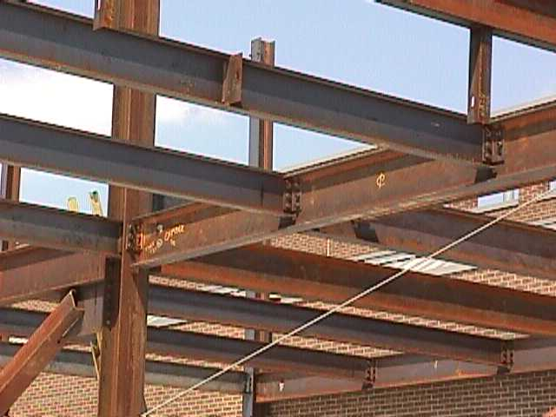
Introduction to Beams
A beam is a horizontal structural member used to support loads
Beams are used to support the roof and floors in buildings

Slide 8
Beam Theory
Consider a simply supported beam of length, L. The cross section is rectangular, with width, b, and depth, h.
h
b
L

Slide 9
Beam Theory
An area has a centroid, which is similar to a center of gravity of a solid body.
The centroid of a symmetric cross section can be easily found by inspection. X and Y axes intersect at the centroid of a symmetric cross section, as shown on the rectangular cross section.
Y - Axis
h/2
X - Axis
h/2
b/2
b/2

Slide 10
Beam Theory
An important variable in beam design is the moment of inertia of the cross section, denoted by I.
Inertia is a measure of a body’s ability to resist rotation.
Moment of inertia is a measure of the stiffness of the beam with respect to the cross section and the ability of the beam to resist bending.
As I increases, bending and deflection will decrease.
Units are (LENGTH)⁴, e.g. in⁴, ft⁴, cm⁴

Slide 11
Beam Theory
I can be derived for any common area using calculus. However, moment of inertia equations for common cross sections (e.g., rectangular, circular, triangular) are readily available in math and engineering textbooks.
For a rectangular cross section,
b is the dimension parallel to the bending axis. h is the dimension perpendicular to the bending axis.
X-axis (passing
through centroid)
h
b

Slide 12
Beam Formula
Shear and moment diagrams
Simple beam (uniformly distributed load)
  Reaction force formula
  Maximum moment formula
Simple beam (concentrated load at center)
  Reaction force formula
  Maximum moment formula

Slide 13
Beam Formulas
Similar loading conditions = similar shear and moment diagrams
Standard formula can represent the magnitude of shear and moment based on loading condition
Magnitude of shear and bending moment depend on
  Span length of beam
  Magnitude of applied load
  Location of applied load
Notes:
You may have noticed that some patterns emerged in the shear and bending moment diagrams during the last Activity (3.2.3). In fact, two beams that are loaded in a similar way will have shear and bending moment diagrams that exhibit the same shape, even though the beam span length and load magnitude are different.

Slide 14
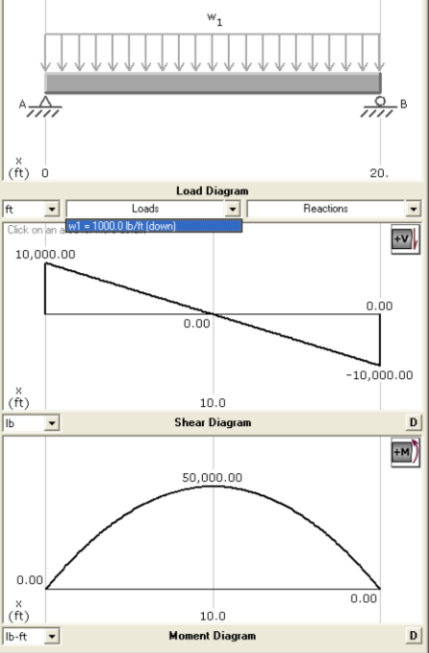
Shear and Moment Diagrams
Simple Beams (Uniformly Distributed Load)
Uniform load = 1000 lb/ft
L = 20 ft
Uniform load = 1200 lb/ft
L = 35 ft
Notes:
For instance, both of these beams are simply supported and loaded with a uniformly distributed load along the entire span of the beam. The left beam is 20 feet long and is loaded with a 1000 lb/ft uniform load. The right beam carries a 1200 lb/ft load and is 35 feet long.
Notice that the shape of the shear diagrams are the same for the two beams. The shape of the bending moment diagrams are also the same for the two beams. In fact, every simply supported beam with a uniformly distributed load will exhibit the same shape of shear and moment diagrams.
Although the diagram shapes are the same, the magnitude of the shear and bending moments differ. This is because the beam spans and the magnitude of the applied loads are different.
Remember from your earlier beam analysis that you used the equations of equilibrium to calculate the end reaction forces. The calculations always followed the same procedure for every beam. The only difference in calculations for two similarly loaded beams is the magnitude of the load and the span length of the beam. We can find a formula to represent the magnitude of the reaction forces that is true for every simply supported beam with a uniform load. The formula will use variables to represent the span length and the magnitude of the applied load since these will change from beam to beam.
Because the shear and bending moment diagrams are dependent on the reaction forces and the length of the beam, we can also derive a formula to provide the maximum bending moment experienced by a beam. Again, the span length and magnitude of the applied load will be variable. If all simply supported beams that carry a uniform load exhibit similar shear and bending moment diagrams, it stands to reason that we should be able to find mathematical formulas to represent the shear and moment magnitudes. The beam span length and the magnitude of the load will be variables because they will change.

Slide 15
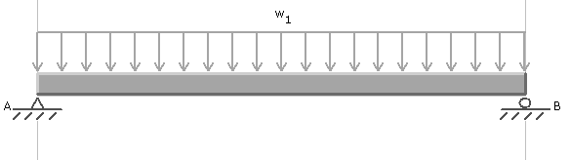
Reaction Force Formula
w
A
B
L
Beam Diagram
Notes:
Find the beam formulas for a simply supported beam with a uniform load across the entire span.
First, we will find formulas for the end reactions. One or both of the end reactions will typically be equal to the maximum shear.
Then we can use the algebraic representations for the end reactions to find the formula for the maximum moment.

Slide 16
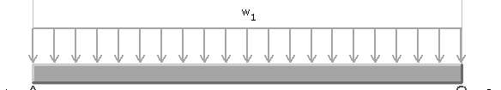





Reaction Force Formula
A
B
R_{A}
R_{B}
L
+
Notes:
Find formulas for the end reactions of a uniformly distributed load on a simple beam. Remember, we can neglect the horizontal reaction force at the pinned connection (A) since there are no horizontally applied loads.
Use the equations of equilibrium. First sum the moments about a point. One of the end points will be most efficient, but it doesn’t matter which point. Let’s choose point A.
The reaction force at point A for a simple supported beam with a uniform load will always be wL/2.

Slide 17





Reaction Force Formula
w
B
A
R_{A}
R_{B}
L
+
Since
Notes:
Next sum the vertical forces.
Both RA and RB are equal to wL/2.
In fact, whenever the beam loading is symmetrical, the end reaction forces will be equal.

Slide 18



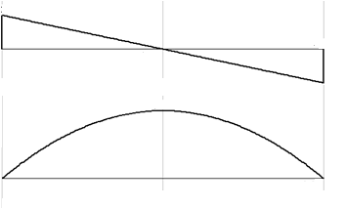



Maximum Moment Formula
w
B
A
L
Shear
Moment
Notes:
NOTE: Click the mouse to display the shaded area and Mmax = shaded area. Then click again to show each line of the derivation.
Because RA is wL/2, the magnitude of the shear at point A will be wL/2 as well. The shear will decrease at a rate equal to the magnitude of the applied uniform load (w) resulting in the shear diagram shown. The point of zero shear is at mid-span. In fact, the point of zero shear will be at mid span for all symmetrically loaded beams.
To find the maximum moment, (click the mouse) find the area of the shear diagram to the left of the point of zero shear (mid-span) which is shaded in the diagram.
The area of a triangle is A = .5 b h (Click the mouse).
Therefore, the maximum moment for every simple beam loaded with a uniform load is wL^2/8 (Click the mouse).

Slide 19


Beam Formula
Simple Beam (Uniformly Distributed Load)
w
A
B
L
Beam Diagram
(at center)
(at center)
Notes:
The resulting formulas are often presented in tables with a beam diagram showing the loading condition.
A similar but more complicated derivation can be performed for the deflection of a beam. The deflection formula for a simple beam with a uniformly distributed load along the entire beam is also shown. We will look at deflection more closely later in the lesson.

Slide 20
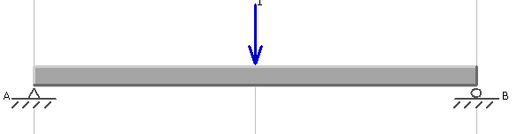
Simple Beam
(Concentrate Load at Center)
Find a formula for the end reaction forces and for the maximum moment for a simply supported beam with a single concentrated load, P, applied at center span.
P
L

Slide 21
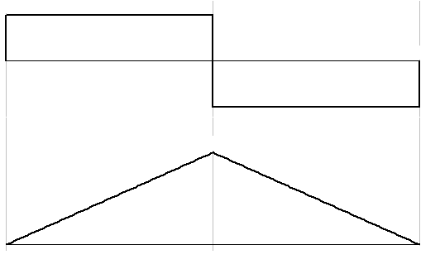





Your Turn
Simple Beam (Concentrate Load at Center)
Notes:
Use the equations of equilibrium to find the end reactions for the beam.
NOTE: Let students attempt to find the formula for the end reactions before clicking the mouse to display the derivation.
Summation of moments results in RA = P/2
Summation of vertical forces results in RB = P/2

Slide 22



Your Turn
Simple Beam (Concentrate Load at Center)
Notes:
Note: Let students attempt to find the Mmax before clicking the mouse to display the derivation.
The shear diagram will show the magnitude of RA at the left (P/2) which will remain unchanged until mid-span where the concentrated load is applied. The concentrated load causes a vertical drop of P at mid span. Therefore, the right half of the beam must carry a shear of –P/2.
The moment diagram will display two linear segments with slopes equal to the shear values.
The maximum moment can be calculated by finding the area under the shear diagram to the left of the point of zero shear (which is shaded).

Slide 23


Beam Formula
Simple Beam (Concentrated Load at Center)
P
(at point of load)
L
(at point of load)

Slide 24
CONCRETE BEAM
Loading stages
fc < f’c
fc < f’c
fc < f’c
fc < f’c
fc = f’c
1
2
3
4
5
ft < f’t
ft = f’t
fs < fy
fs = fy
fs = fy
1 : Little weight
2 : Concrete stress reaches modulus of rupture
3 : Concrete cracks and steel resists tension
4 : Steel yields
5 : Collapse condition

Slide 25
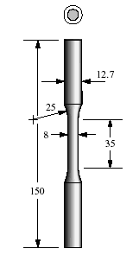
Structural steel
All dim. in mm

Slide 26
DESIGN STRENGTH
OF STEEL
415
fy
400
fy /1.15
= 0.87 fy
1.00 fy
design value
0.87 fy
stress N / sq mm
design
value
stress
strain
0 .002 .004 .005
strain
HIGH YIELD
STRENGTH BARS
MILD STEEL

Slide 27
CHARACTERISTIC STRENGTH
OF STEEL
500
450
Fe 415
400
350
300
Stress - N / sq mm
Fe 250
250
200
150
100
50
0
e_{s} (%)
0.1 0.2 0.3 0.4 0.5 0.6

Slide 28
DESIGN STRENGTH OF CONCRETE
1.00 fck
0.67 fck
stress
design value
0.446 fck
ecu = 0.0035
0.0 0.001 0. 002 0. 003
strain

Slide 29
CHARACTERISTIC STRENGTH
CONCRETE
1.00 fck
0.67 fck
stress
ecu
0.0 0.001 0. 002 0.0035
strain

Slide 30
Singly reinforced beam
Working Stress
ε_{c}
σ_{cb}
nd/3
C
nd
N A
h
d
jd
T
ε_{s}
σ_{st}
A_{st}

Slide 31
CONCRETE STRESS BLOCKS
e_{cu}
0.446 fck
= 0.0035
k x_{u}
3x_{u} / 7
C
x_{u}
4x_{u} / 7
Neutral axis
O
O
O
ACTUAL
STRESS
BLOCK
STRAIN
DIAGRAM
DESIGN STRESS
BLOCK

Slide 32
Singly reinforced beam
Limit State
b
e_{cu}
kx_{u}
x_{u}
C
d
d - kx_{u}
N E U T R A L A X I S
T
e_{su}
As

Slide 34
PURE BENDING
RECTANGULAR SECTION
0.446 fck
k.x_{u}
k xu
C
3xu / 7
C
d - kx_{u}
4xu / 7
T
Total compression
A
B
C = b{0.446 fck (3x_{u} ) + 0.446 fck 2 ( 4 x _{u} )}
7 3 7
= 0.36 fck . x _{u} . b

Slide 35
Distance of center of gravity of compression force
from top fiber,
k . x _{u} = b A . 3 x _{u} . 1 + B ( 3 x _{u} + 3 . 4 x _{u} )
C 7 2 7 8 7
= 0.416 x _{u} ie k = 0.416
Total compression = Total tension
0.36fck. x _{u} b = 0.87 . f y . As from which,
k_{u} = x _{u} / d = 2 .417 fy (p) where p = As / bd
fck
Ultimate Moment
Mu = C (d - k x _{u})
= 0.36 fck . x _{u}.b( d – 0.416 x _{u})
= Q . bd ²

Slide 36
where Q = 0.36 k _{u} fck ( 1 – 0.416 k _{u})
Solving earlier equation for x _{u} gives ,
___________________
k _{u} = x _{u} / d = 1.2 { 1 - √ 1 - 4.62 Mu / fck bd ² }

Slide 37
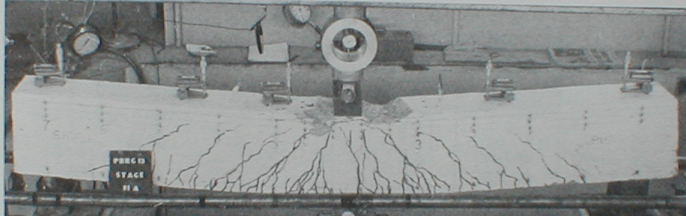
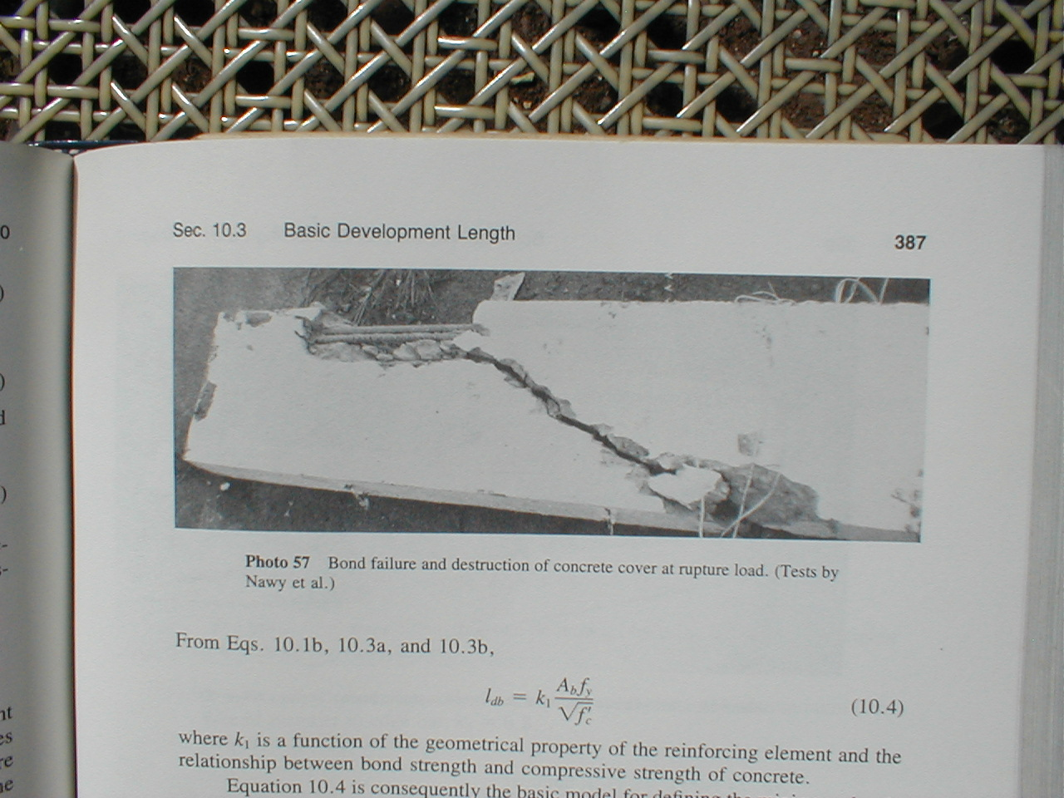
FAILURE IN FLEXURE
FAILURE IN BOND

Slide 38
SHEAR STRESS

Slide 40
SHEAR FORCE
EQUILIBRIUM
SHEAR
FORCE
Comp. force
in concrete
RC BEAM
Aggregate
interlock force
Reinforcement
Dowel force in steel

Slide 41
The shear force V is resisted by
Vc , from the un-cracked concrete compression zone,
Vd, from the dowel action of longitudinal reinforcement.
Va, from vertical component of the force due to aggregate interlock or interface shear transfer.
V = Vc + Vd + Va

Slide 42
SHEAR CONCEPTS
Compression diagonal
Compression chord
Tension diagonal
Tension chord
s
d’ = cover + ϕ / 2
d
d
≅ d – d’
Shear resisted by stirrups
Vu = stress (area of stirrup)(number of stirrups in
length ‘d’) = 0.87fy x Av x d / s

Slide 43
SHEAR CONCEPTS
1 No 20 mm
dia bent bar
10 mm dia
stirrups
5 Nos 22 mm
dia bars
Shear resisted bent up bars
0.87 fy As Sin 45

Slide 44
Location of Maximum Shear for Beam Design
d
Compression fan carries load
directly to support

Slide 45
CLASSIFICATION OF LIMIT STATES
1 COLLAPSE
2 STABILITY
Compression
Sliding
Tension
Overturning
Shear
Buckling
Bending
Sinking
Torsion
3 SERVICEABILITY
4 DURABILITY
Deflection
Fire damage
Cracking
Environmental
attack
Vibration

Slide 46
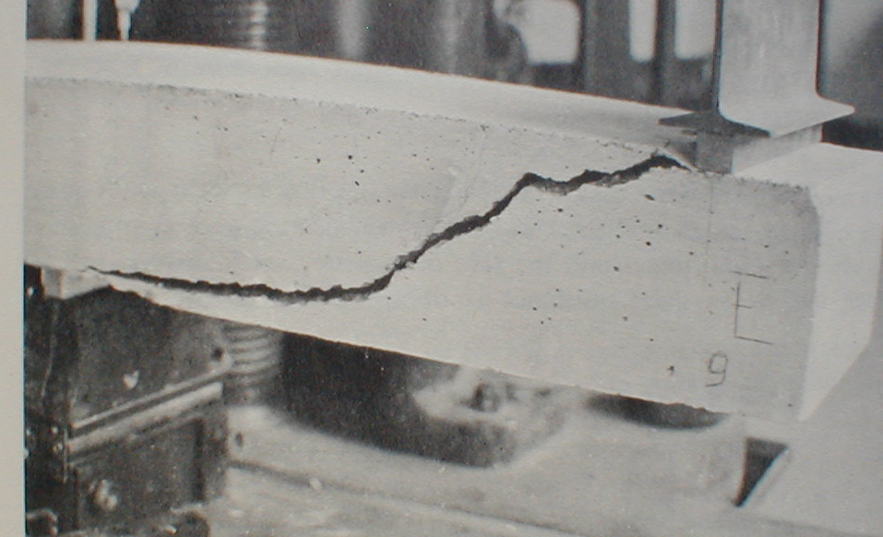
SHEAR FAILURE

Slide 47
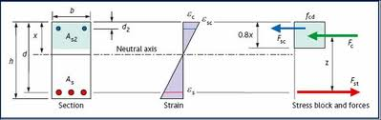
STRONGER BEAMS
0.0035
dc
esc
x_{u}
d
DOUBLY REINFORCED

Slide 48
Df
xu
C
FLANGED
BEAMS
Case1 x_{u}< Df
T
Df
3xu/7
xu
Case2a 3x_{u}/ 7 < Df
T
Df
3xu/7
xu
Case2b 3x_{u}/ 7> Df
T

Slide 49
Various Possible Geometries of Flanged Beams
T
Double T
L
Box
I

Slide 50
FLANGE WIDTH FOR T BEAMS
bf
bf
x1
x1
x2
x2
bw
bw
(a) For T beams
bf = lo/6 +bw + 6 Df and bf = bw + x1 + x2 ; whichever
is less
(b) For isolated T beams
bf = 0.5 lo / (lo/b +4) + bw and bf = b; whichever is less
bf = effective width of flange bw = breadth of web
b = actual width of flange
lo = distance between points of zero moment in a beam ;
(for continuous beams lo = 0.7 Le)
Df = thickness of slab / flange
x1 , x2 are half of clear distance between adjacent beams

Slide 51

BAR ANCHORAGE
T
Ld
T = 0.87 fy .As
= 0.87 fy π ϕ²
4
R = fb . Ld . π ϕ
R = T
fb . Ld . π ϕ
= 0.87 fy π ϕ²
4
Ld = 0.87 fy ϕ / 4 fb

Slide 52
BAR ANCHOR LENGTH
fy
N / mm²
Anchor length for conc. grade of :
M20
M25
M30
250
45.3ϕ
38.8ϕ
36.3ϕ
415
47.0ϕ
40.3ϕ
37.6ϕ
500
56.6ϕ
48.6ϕ
45.3ϕ
fy
N/mm²
Anchor length for conc. grade of :
M20
M25
M30
250
45ϕ
40ϕ
40ϕ
415
50ϕ
40ϕ
40ϕ
500
57ϕ
50ϕ
45ϕ

Slide 53

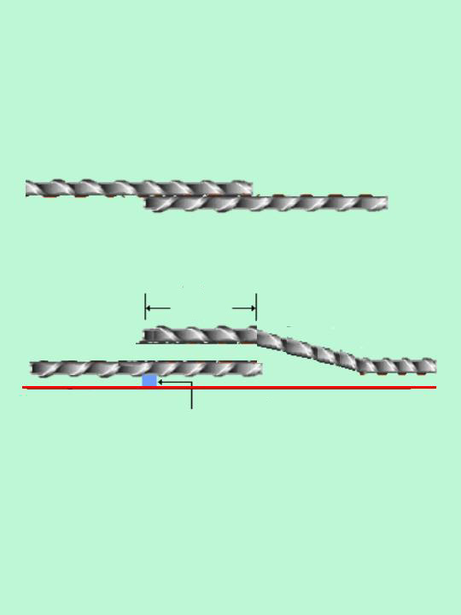
LAPPING OF REBARS
Lap
length
Slope
≥ 1 in 6
Outer face
of concrete
Cover

Slide 54
PRESTRESSED CONCRETE
WHAT IS WEAKNESS OF RCC?
  IN CONCRETE, COMPRESSIVE STRENGTH IS HIGH
  IN TENSION ZONE CONCRETE CRACKS AND IS INEFFECTIVE
CAN WE DO SOMETHING?
  DON’T ALLOW TENSION

Slide 55
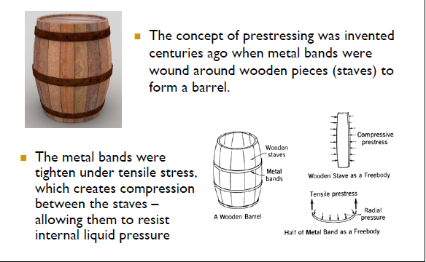
PRESTRESSING IS OLD CONCEPT

Slide 56
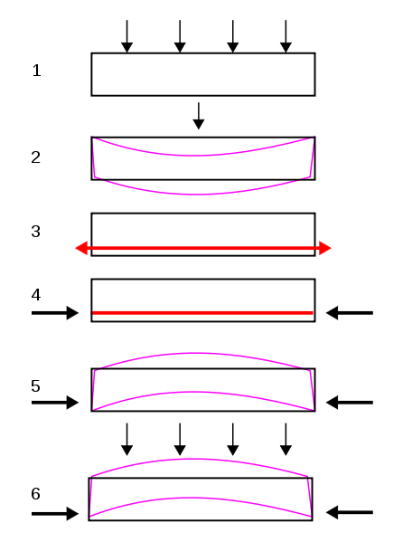

Slide 57
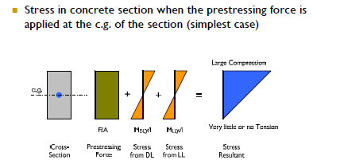

Slide 58
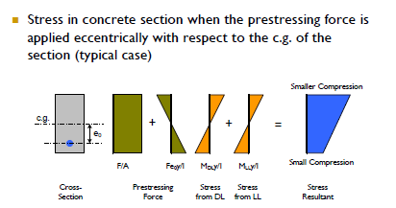

Slide 60
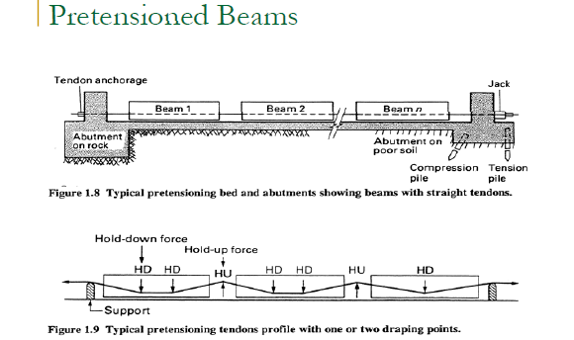

Slide 61
CONCRETE SLEEPER, MOST COMMON PSC ELEMENT

Slide 63
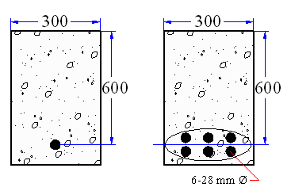
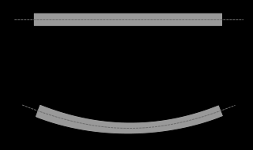
DESIGN OF CONCRETE BEAMS
Working Stress Method

